Slide 1
Exercise 3 Prove the inconsistency of the following set of clauses using lock resolution. Try two different indexing for the literals.
Arba Catalina
Group 911
23.11.2021

Slide 2
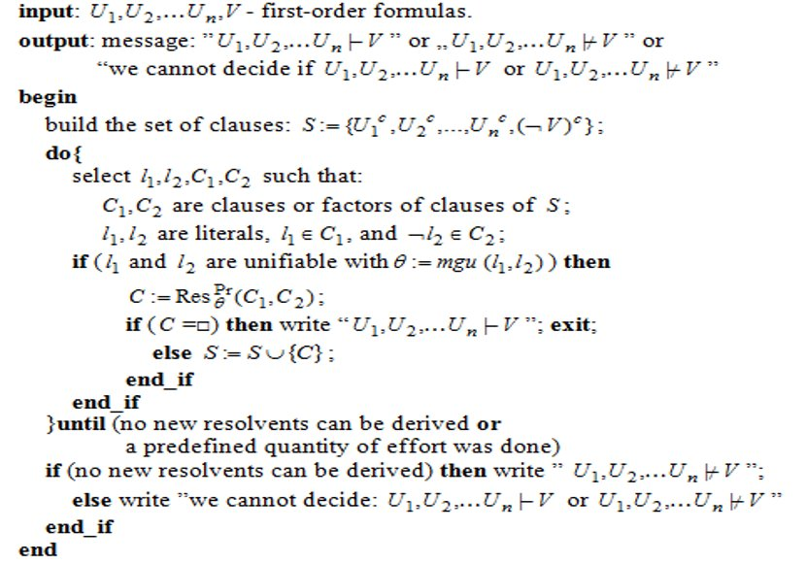
The Algorithm for Predicate Resolution

Slide 3
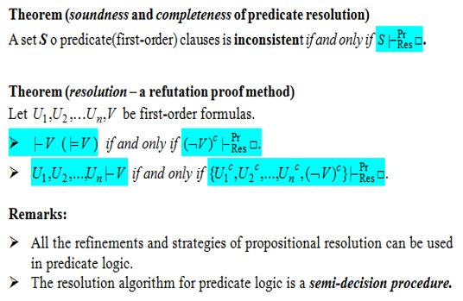
Theoretical results

Slide 4
The solution
The literals are indexed as follows
C₁= ₍₁₎¬P(x) ∨ ₍₂₎Q(x)
C₂= ₍₃₎P(a)
C₃=₍₅₎ ¬ Q(x) ∨ ₍₄₎¬R(x)
C₄= ₍₆₎¬W(a)
C₅=₍₈₎ R(y) ∨ ₍₇₎W(y)
The following resolvents are obteined:
C₆ = Res^{Pr}₀₁= [x<-a](C₁,C₂) = ₍₂₎Q(a)
C₇ = Res^{Pr} ₀₂= [y<-a](C₄,C₅) =₍₈₎ R(a)
C₈ = Res^{Pr}₀₃ = [x<-a](C₃,C₇) = ₍₅₎¬Q(a)
C₉ = Res^{Pr} = (C₆,C₈) = □
=>S|-^{locr Pr} _{Res} □ is inconsistent

Slide 5
Different indexings for the literals.
The literals are indexed as follows
C₁= ₍₂₎¬P(x) ∨ ₍₁₎Q(x)
C₂= ₍₃₎P(a)
C₃=₍₄₎ ¬ Q(x) ∨ ₍₅₎¬R(x)
C₄= ₍₆₎¬W(a)
C₅=₍₇₎ R(y) ∨ ₍₈₎W(y)
The following resolvents are obteined:
C₆ = Res^{Pr}= (C₁,C₃) = ₍₂₎¬P(x) ∨ ₍₅₎¬R(x)
C₇ = Res^{Pr} ₀₁= [x<-a](C₂,C₆) =₍₅₎ ¬R(a)
C₈ = Res^{Pr}₀₂ = [y<-a](C₅,C₇) = ₍₈₎W(a)
C₉ = Res^{Pr} = (C₄,C₈) = □
=>S|-^{locr Pr} _{Res} □ is inconsistent

